Slide 1
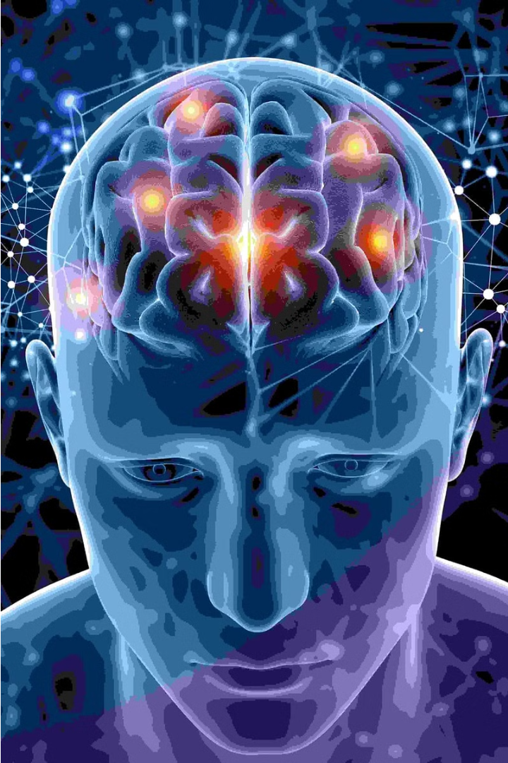

Introduction to Neuro-Marketing
Neuro-marketing is a rapidly evolving field that utilizes insights from neuroscience to better understand consumer behavior and decision-making. By studying the subconscious responses of the brain, marketers can create more effective and targeted campaigns.

Slide 2
Understanding the Gen Z Demographic
Digital Natives
Diverse and Inclusive
Socially Conscious
Gen Z, born between 1997 and 2012, are true digital natives who have grown up with constant access to technology and social media.
This generation is the most racially and ethnically diverse in history, and they prioritize brands that champion diversity and inclusivity.
Gen Z is known for their strong social and environmental consciousness, and they expect brands to be purpose-driven and socially responsible.

Slide 3

The Power of Subconscious Decision-Making
1
Emotional Triggers
Neuro-marketing research suggests that much of our decision-making is driven by subconscious, emotional responses rather than conscious, rational thought.
2
Sensory Cues
Things like color, sound, and smell can have a powerful impact on our subconscious perceptions and purchasing decisions.
3
Cognitive Biases
Marketers can leverage various cognitive biases, such as the halo effect or anchoring bias, to influence consumer behavior.

Slide 4
Neuro-Marketing Techniques and Strategies
1
Electroencephalography (EEG)
2
Eye Tracking
Measures brain activity to understand emotional responses and attention levels.
Tracks eye movements to determine what visuals capture consumer focus.
3
Functional Magnetic Resonance Imaging (fMRI)
4
Biometrics
Measures physiological responses like heart rate, skin conductance, and facial expressions.
Measures neural activity to identify which brain regions are activated by marketing stimuli.

Slide 5




Implications of Neuro-Marketing on Gen Z Consumers
Authenticity
Personalization
Sustainability
Gen Z values authenticity and is more likely to respond to marketing that feels genuine and aligns with their values.
Neuro-marketing techniques can help brands create highly personalized experiences that resonate with Gen Z's individual preferences.
Eco-conscious Gen Z consumers are drawn to brands that demonstrate a commitment to sustainability and social responsibility.

Slide 6
Ethical Considerations in Neuro-Marketing
Transparency
Privacy
Brands should be transparent about their use of neuro-marketing techniques and obtain informed consent from consumers.
Strict data privacy policies must be in place to protect consumer information gathered through neuro-marketing research.
Manipulation
Regulation
Neuro-marketing should avoid exploiting subconscious biases in a way that manipulates or harms consumers.
Policymakers and industry groups should establish clear guidelines and regulations to ensure the ethical use of neuro-marketing.

Slide 7




Measuring the Effectiveness of Neuro-Marketing Campaigns
Neurological Metrics
Sales Performance
Consumer Feedback
Marketing Analytics
Measures like brain activity, eye tracking, and biometric signals can quantify the subconscious impact of marketing stimuli.
Analyzing sales data and conversion rates can reveal the real-world impact of neuro-marketing campaigns.
Collecting qualitative feedback and self-reported data from consumers can complement neurological metrics.
Applying advanced analytics and machine learning can uncover deeper insights from neuro-marketing data.

Slide 8
Conclusion and Future Trends
Emerging Technologies
Advancements in technologies like virtual reality, augmented reality, and brain-computer interfaces will further enhance neuro-marketing capabilities.
Ethical Frameworks
As neuro-marketing becomes more widespread, the development of robust ethical guidelines and regulations will be crucial.
Personalization and Relevance
Neuro-marketing will enable brands to create increasingly personalized and relevant experiences that resonate with the unique preferences of Gen Z consumers.

